Slide 1
Knowledge Graph driven Business Text Processing
Lipika Dey & Tirthankar Dasgupta
TCS Research

Slide 2
The Flow
Introduction to Knowledge-graphs
History and Evolution
Business Text Processing with Knowledge Graphs
Business Document Processing and Knowledge Graphs
Information Extraction - NER and Relation extraction
Storing and using Knowledge Graphs
Graph Databases
Knowledge Graph driven Question - Answering (KGQA)

Slide 3

How do we store and process information

Slide 4
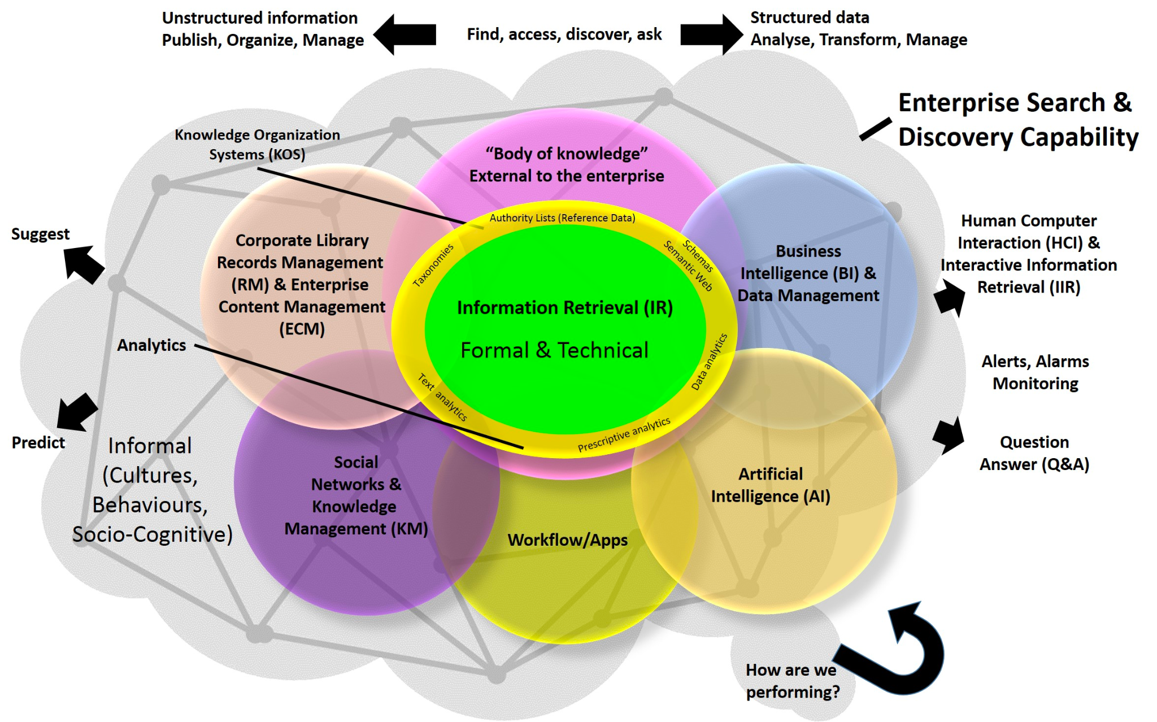
Intelligent Enterprise
Enterprise Intelligence refers to the sum total of all of the relevant information that is available to an organization, and the organization's ability to extract insights and actionable items from all of that data to improve and innovate

Slide 5
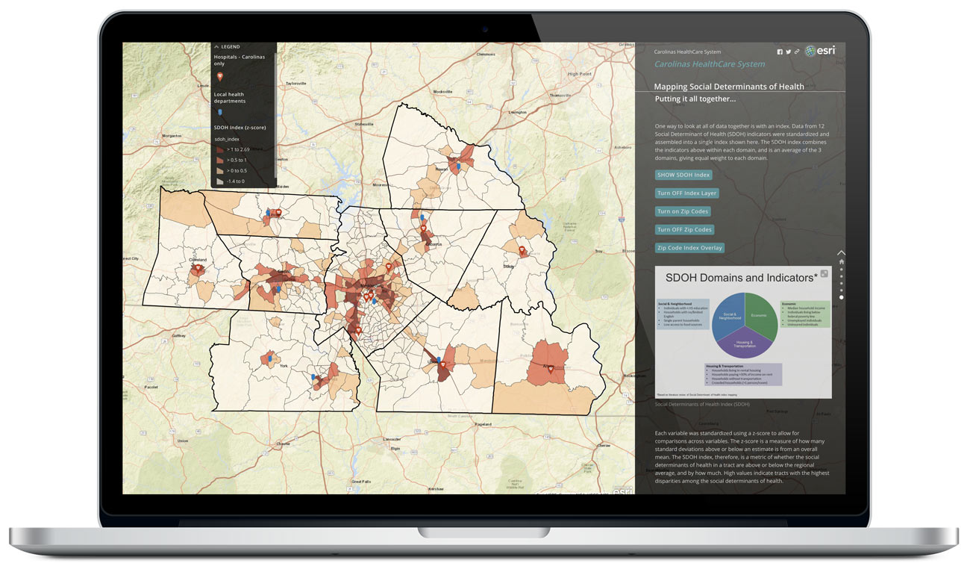
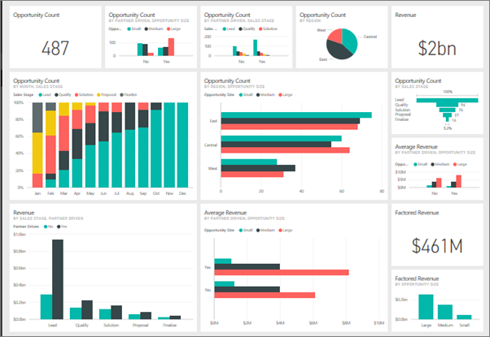
Business Intelligence Today
Beyond Dashboards
Why was sales not as predicted in a particular region?
Did other companies report similar figures?
How is that region different from others?
What could be done to improve figures there?

Slide 6

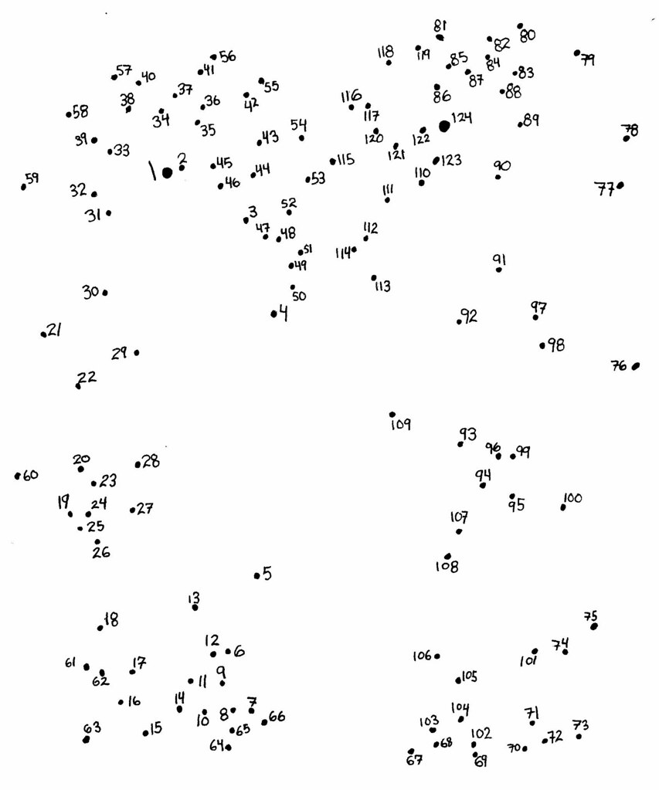

A Tall Order
A Tall Order but not impossible
Vendor communications,
Reports / Internal Communications
Social Media
News
Regulatory changes
Employee feedbacks
Transactional Data
CRM
ERP
Customer communications, Emails, Call Logs
Mushkil hai par na-mumkin nahi!

Slide 7
Enter Knowledge Graphs
Knowledge Graphs
can store complex world knowledge
agglomerated from heterogeneous sources
in a format that is both machine readable and human interpretable
comes with the right reasoning algorithms to facilitate contextually powered data analytics

Slide 8
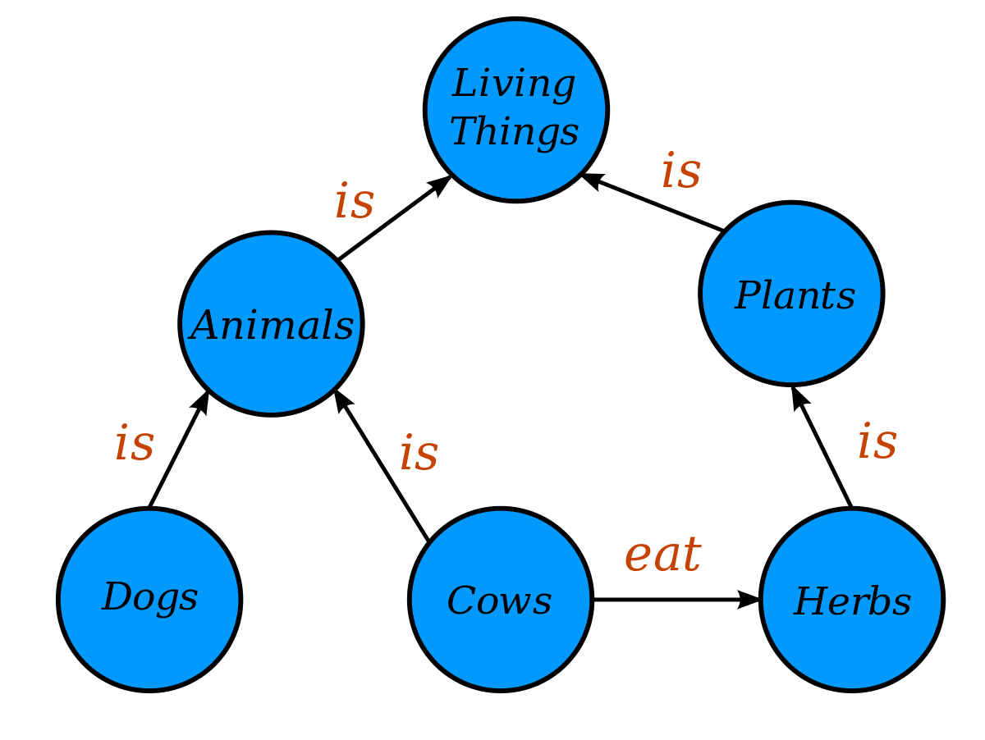
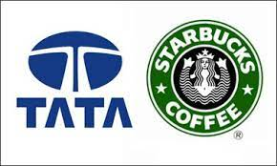
Capturing World Knowledge
Knowledge-graph captures world knowledge in the form of a network of real-world entities and their relations
Starbucks Corpn.
Tata Group
Owns 50%
Owns 50%
S1
S2
S2
Ambi Mall VK
T1 IGIA
T3 IGIA

Slide 9
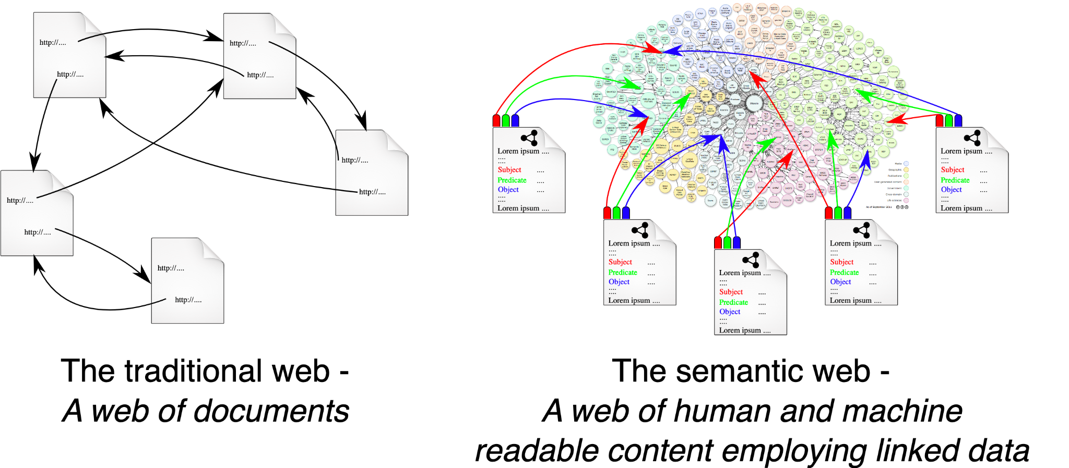
Walking backwards - Semantic Web
Semantic web was a term coined by Berners-Lee in 2000
Can the Internet data be made machine-readable?
A network of hyperlinked web pages, equipped with additional machine-readable metadata about the pages and how they are related to each other would enable intelligent automated agents to access the web and perform tasks on behalf of users

Slide 10
Semantic triples
A semantic triple, or RDF triple or simply triple, is the atomic data entity in the Resource Description Framework (RDF) data model
A triple is a set of three entities that codifies a statement about semantic data in the form of <subject–predicate–object>
"Bob is 35", or "Bob knows John" would be expressed in RDF as
http://example.name#BobSmith12 http://xmlns.com/foaf/0.1/knows http://example.name#JohnDoe3

Slide 11
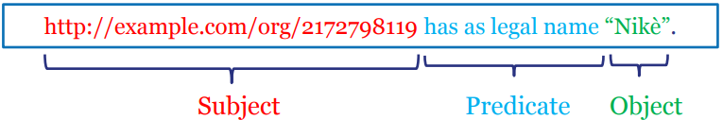
RDF structure: Triples, graphs and syntax.
RDF is a general syntax for representing data on the Web.
Every piece of information expressed in RDF is represented as a triple:
Subject – a resource, which may be identified with a URI.
Predicate – a URI-identified reused specification of the relationship.
Object – a resource or literal to which the subject is related.
Example: name of a legal entity:

Slide 12
RDF as Graph
Nikè
has legal name
http://example.com/ org/2172798119
full address
has registered site
Dahliastraat 24 2160 Wommelgem
http://example.co m/site/1234
full address

Slide 13
RDF Query
SPARQL is the standard language to query graph data represented as RDF triples.
SPARQL Protocol and RDF Query Language
Types of SPARQL queries
SELECT Return a table of all X, Y, etc. satisfying the following conditions ...
CONSTRUCT Find all X, Y, etc. satisfying the following conditions ... and substitute them into the following template in order to generate (possibly new) RDF statements, creating a new graph.
DESCRIBE Find all statements in the dataset that provide information about the following resource(s) ... (identified by name or description)
ASK Are there any X, Y, etc. satisfying the following conditions ...

Slide 14
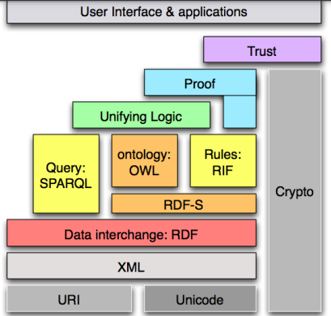
From Relation Triples to RDF
RDF stands for: -
Resource: Everything that can have a unique identifier (URI), e.g. pages, places, people, dogs, products...
Description: attributes, features, and relations of the resources
Framework: model, languages and syntaxes for these descriptions
Published as a W3C recommendation in 1999

Slide 15
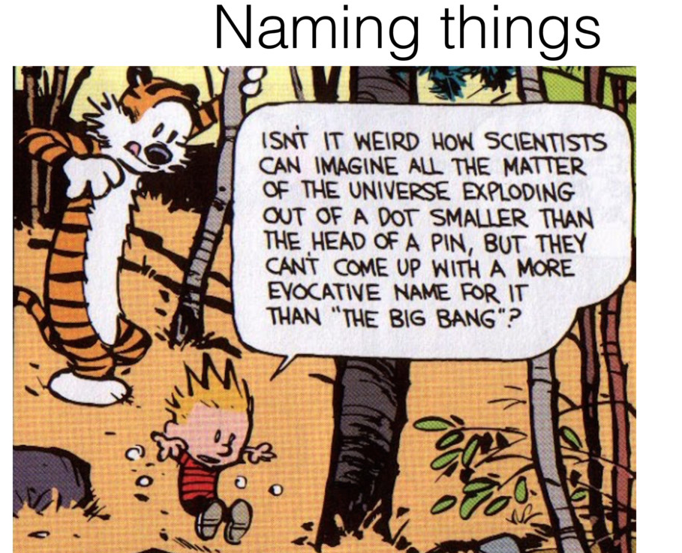
Too Complex and theoretical!
Built by the academics for the academics!
Agreement on concept hierarchy next-to-impossible
Manual curation not possible
Not accessible to many developers, and not scalable to industrial workloads!

Slide 16
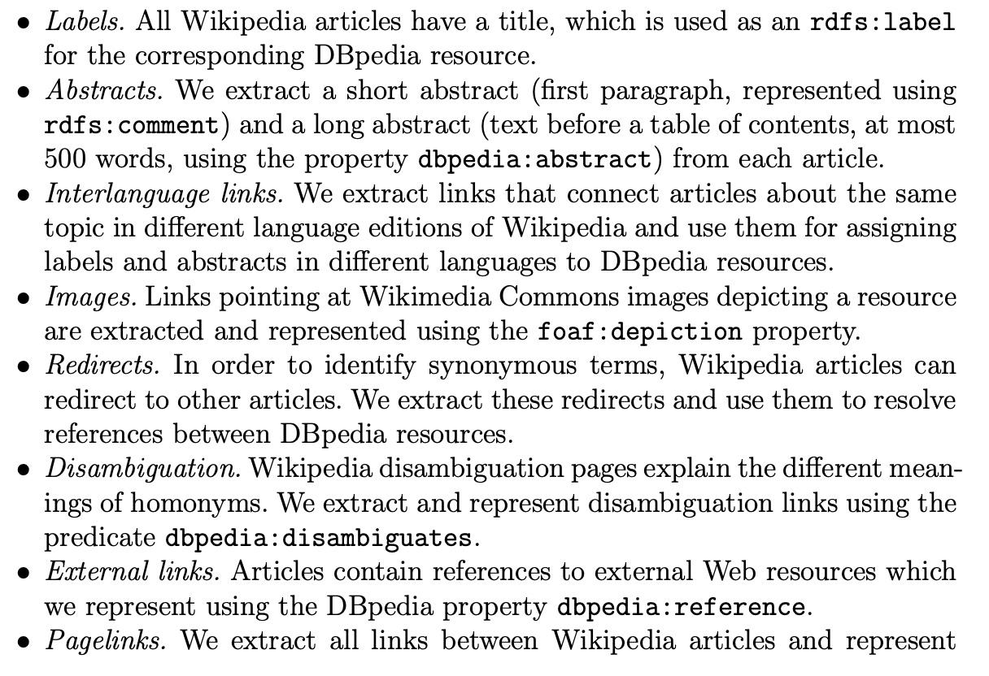
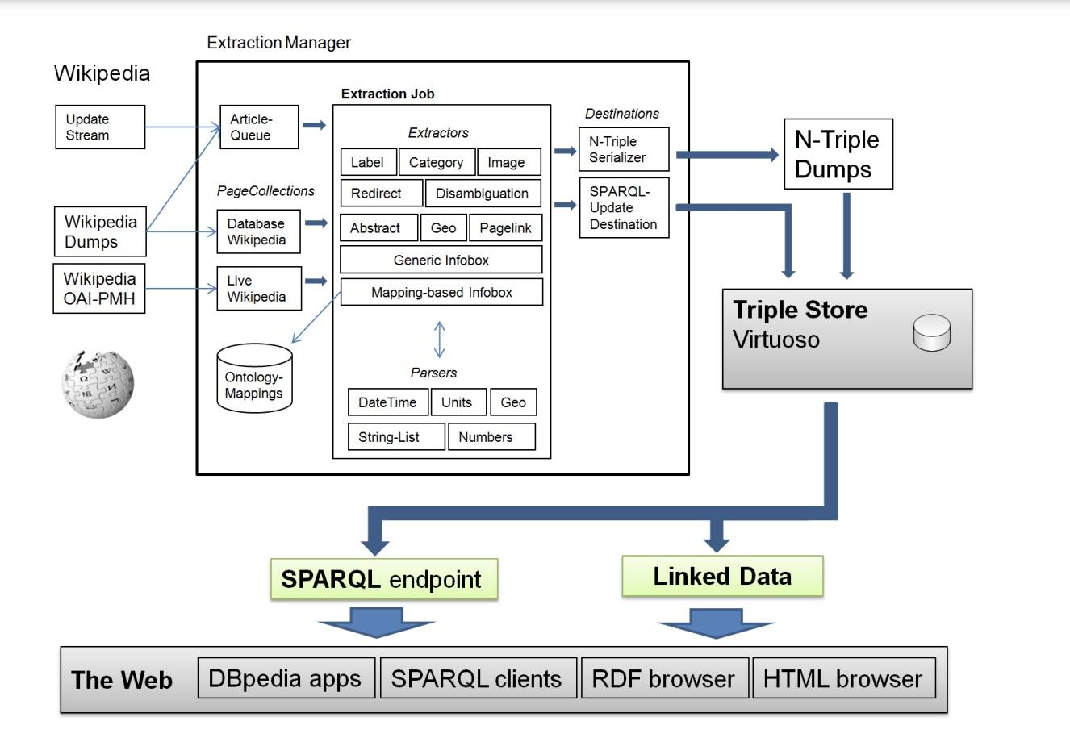
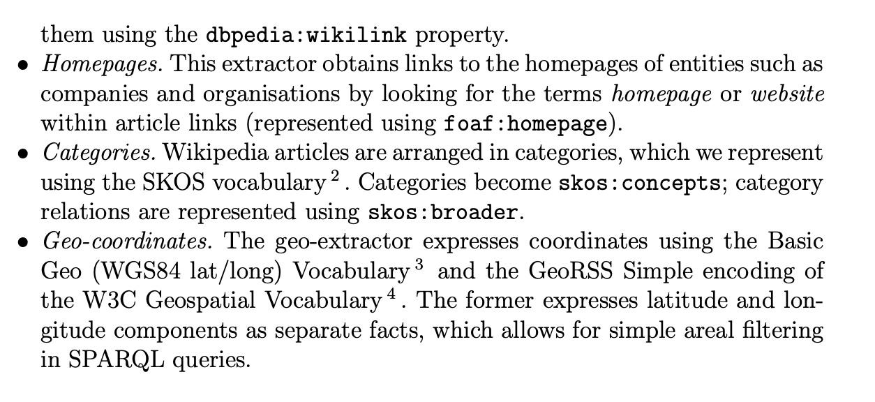
Dbpedia
The DBpedia project leverages Wikepedia - extracts structured information from Wikipedia and makes this information accessible on the Web through queries

Slide 17
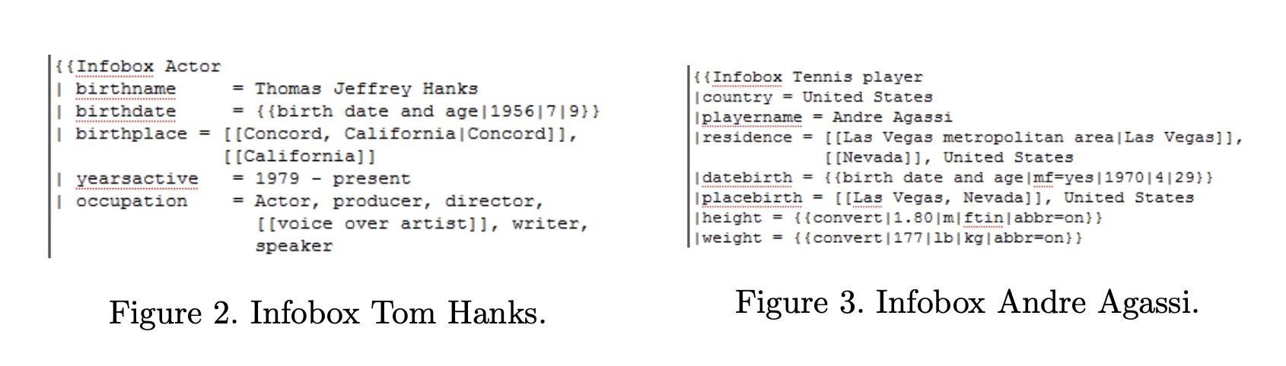
Wikipedia Infoboxes
Used a manually created ontology arranging the 350 most commonly used infobox templates within the English edition of Wikipedia into a subsumption hierarchy consisting of 170 classes and then mapping 2350 attributes from within these templates to 720 ontology properties.
Bizer et al., DBpedia - A Crystallization Point for the Web of Data 2009

Slide 18
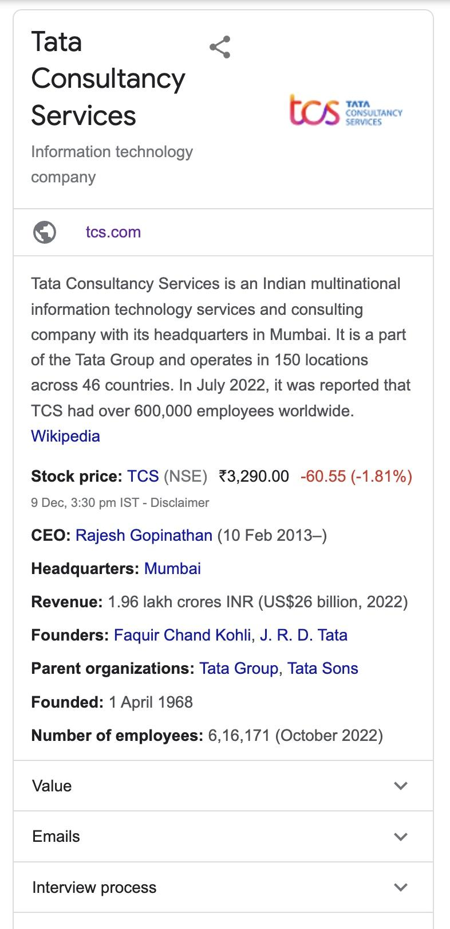
Google Knowledge Graph - not strings but things
Google Knowledge Graph is filled with billions of facts on various people, places, and things
Wikipedia and the CIA Factbook
Enables searching for things, people or places that Google knows about — landmarks, celebrities, cities, sports teams, buildings, geographical features, movies, celestial objects, works of art and more — and instantly get information that’s relevant to the query

Slide 19
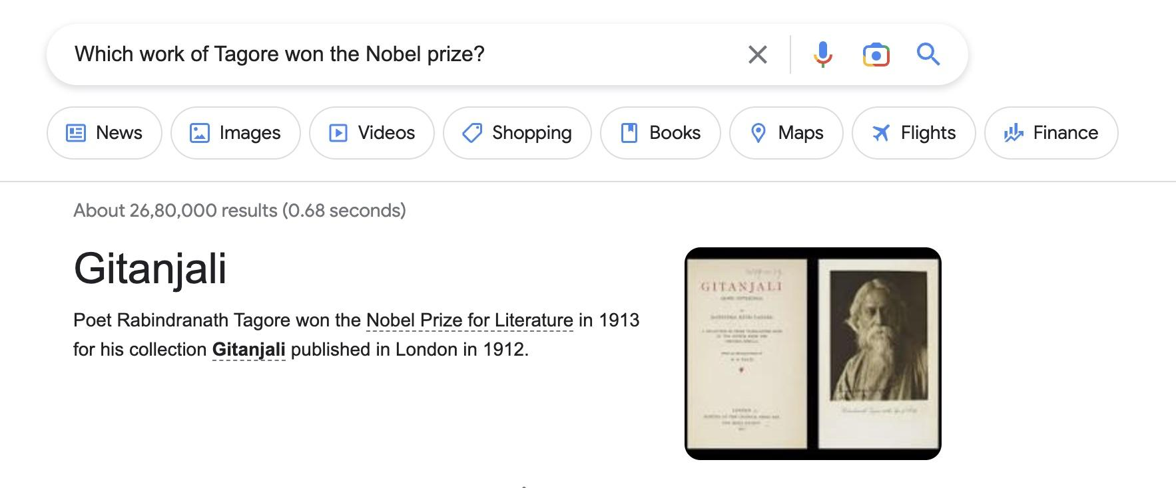
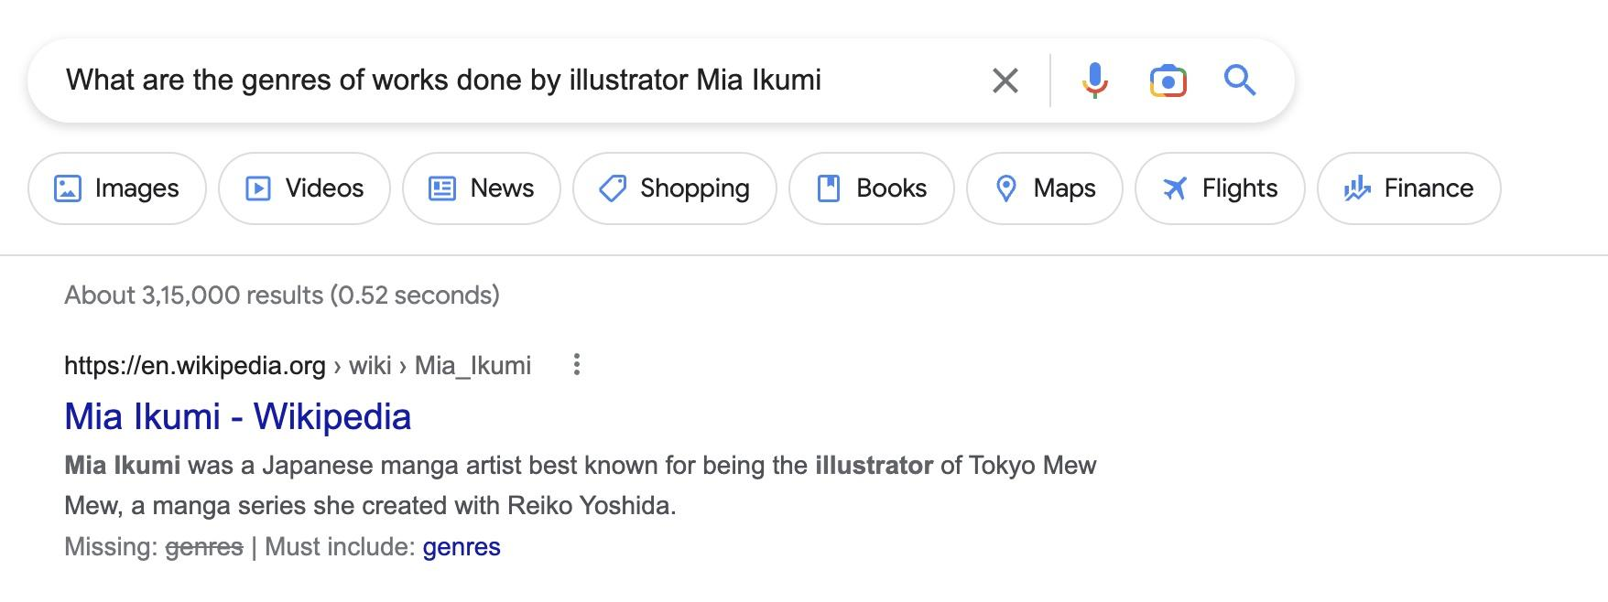
Knowledge Graphs make search easier

Slide 20
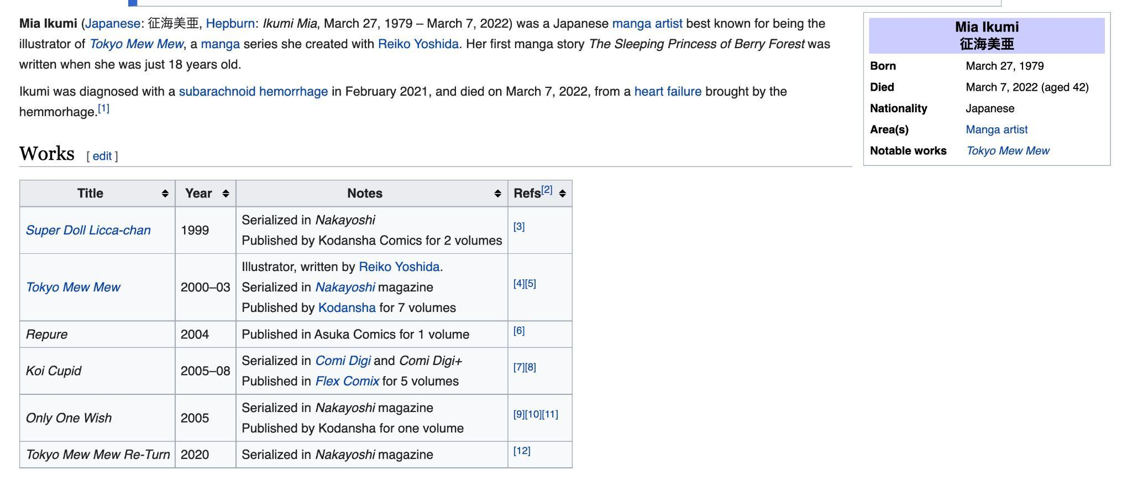
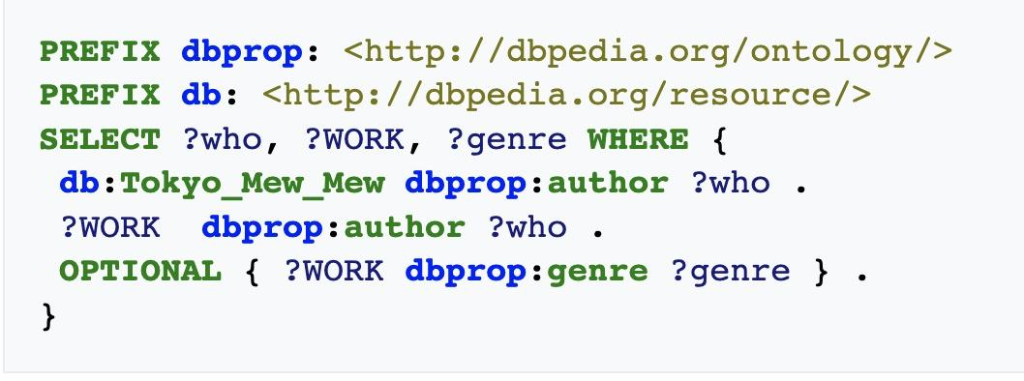
Dbpedia vs Google Knowledge Graph

Slide 21
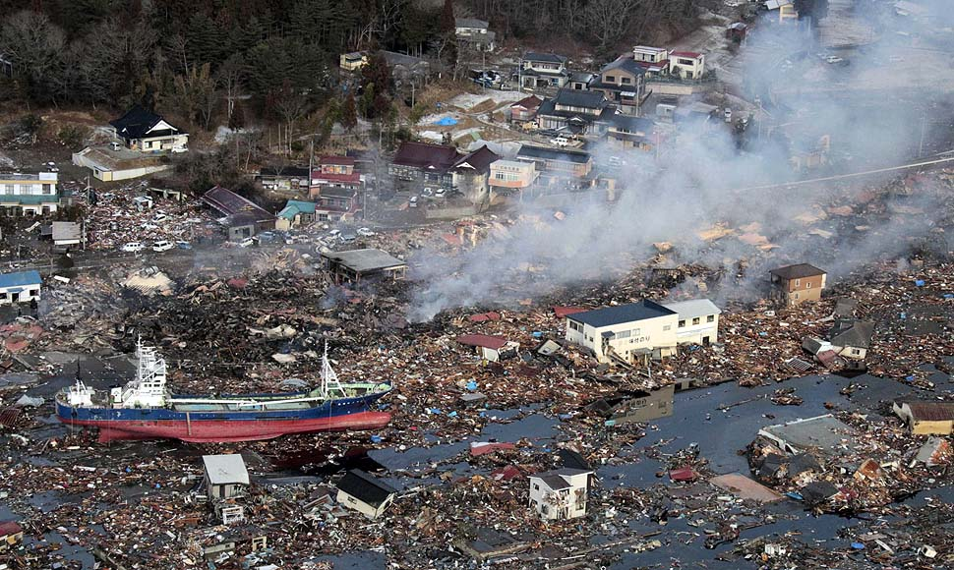
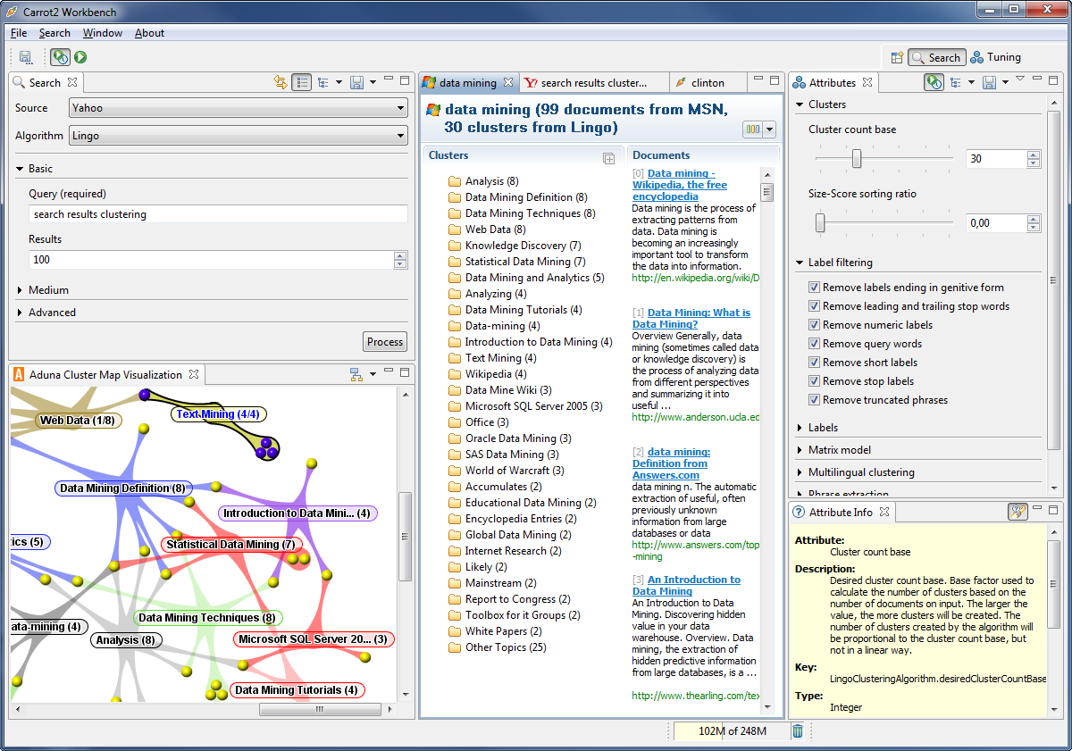
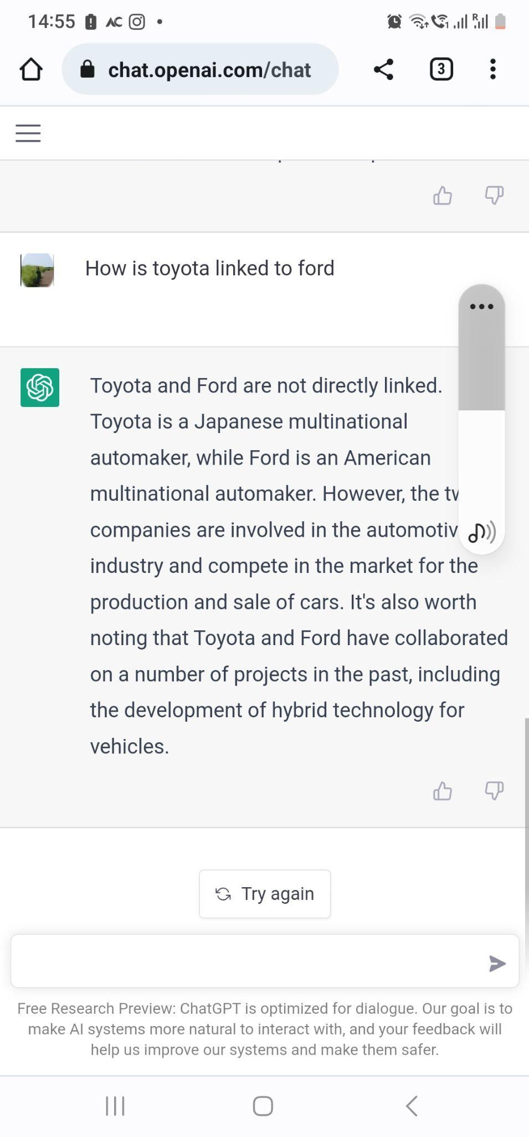
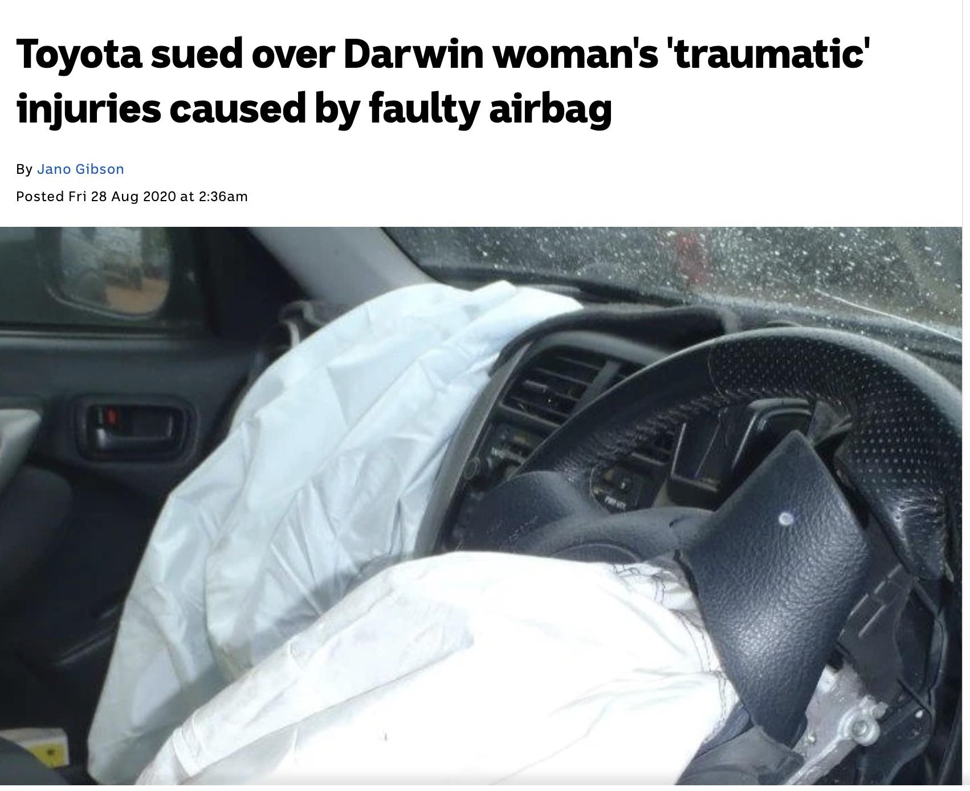
How does all this that help Business?
Check order status with suppliers from Japan
Manual Query
How do these News affect my company?
(FORD / BMW/MARUTI/NISSAN/…)
Tsunami hits Japan
Ask ChatGpt

Slide 22
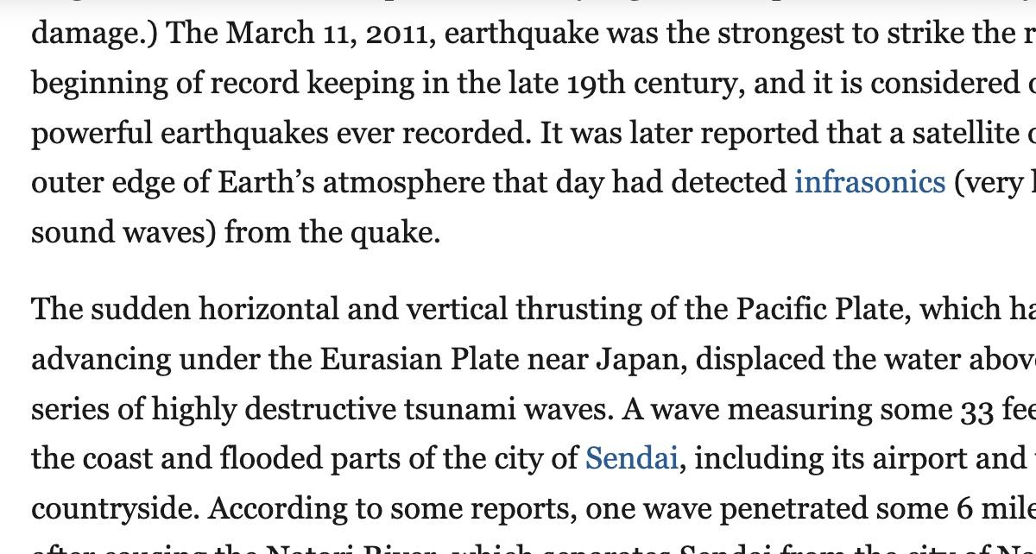
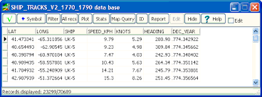
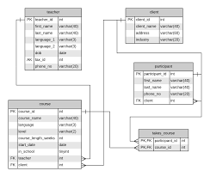
If Semantic analysis could connect information automatically
Takata is_in Japan
Takata manufactures Airbags
Takata supplies_to Maruti
Takata supplies_to Ford
Takata supplies_to Toyota
Tsunami hits Japan
Japan is-a country
Tsunami is_a Natural Disaster
Natural Disaster disrupts business
Ford has_business with Takata
Ford has_business with Flex-N-Gate Seeburn,
Ford has_business with NHK Spring
Ford has_business with Valeo Electric and Electronic Systems
Open source information to be interpreted within the context of business

Slide 23
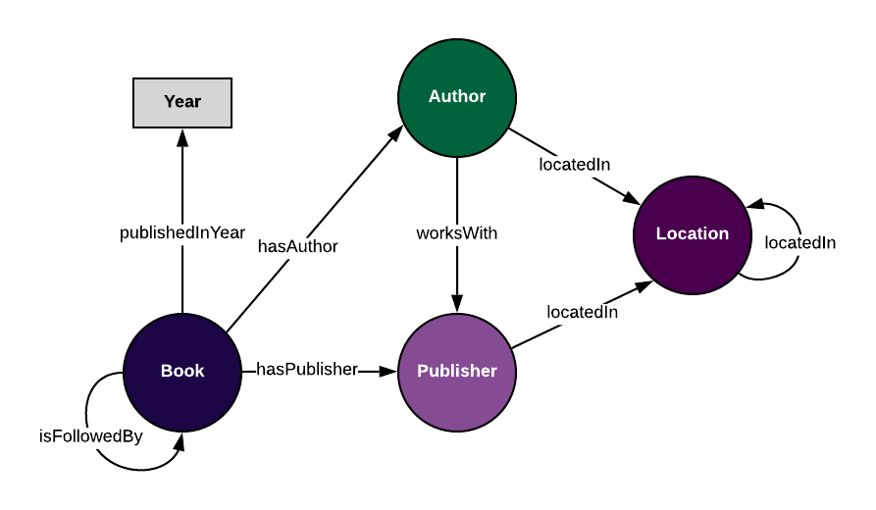
Ontology and Knowledge Graph
Ontologies are generalized semantic data models that define the types of things that exist in our domain and the properties that can be used to describe them -
Classes: the distinct types of things that exist in our data
Attributes: properties that describe an individual class
Relationships: properties that connect two classes
the way these are comprehended and used within organizations
Book - Authors - Publishers - Location

Slide 24
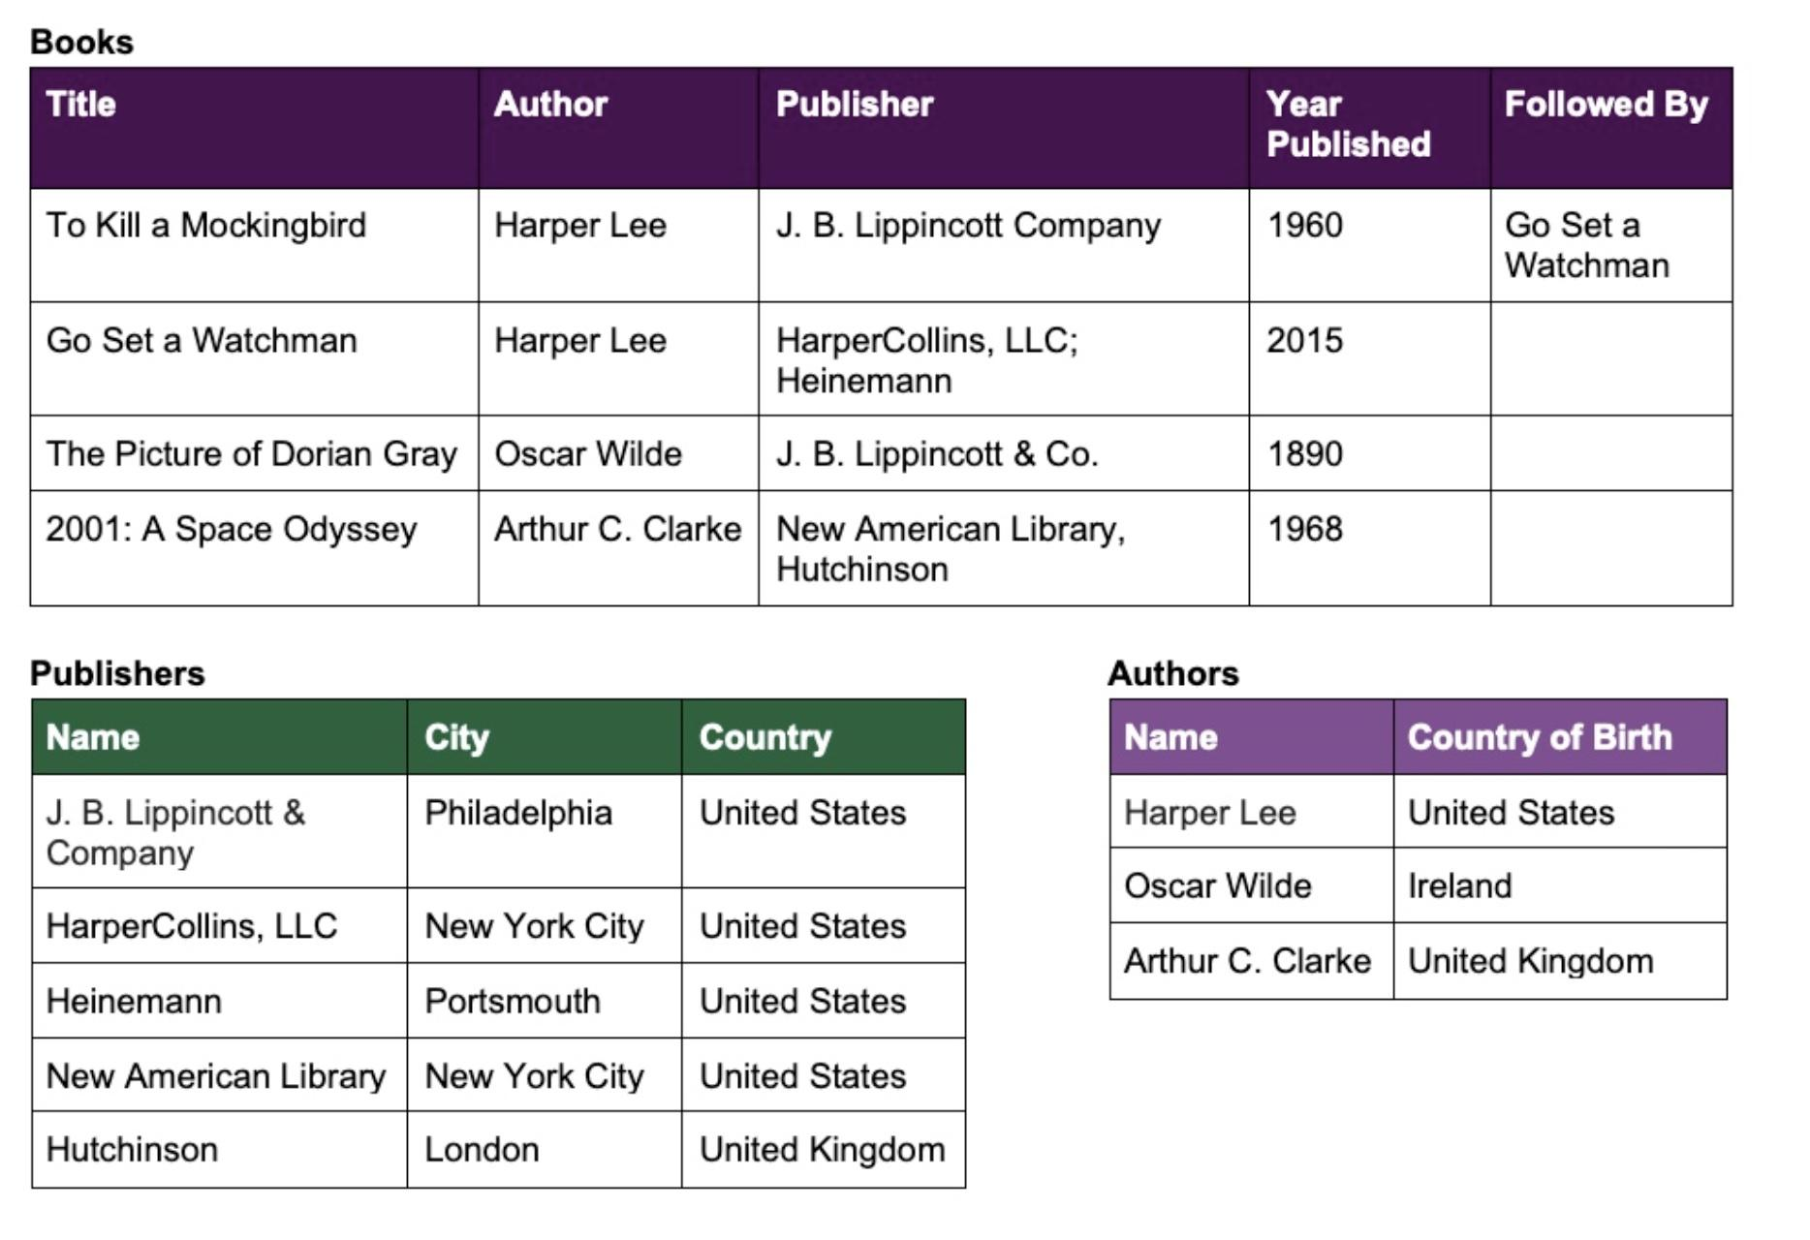
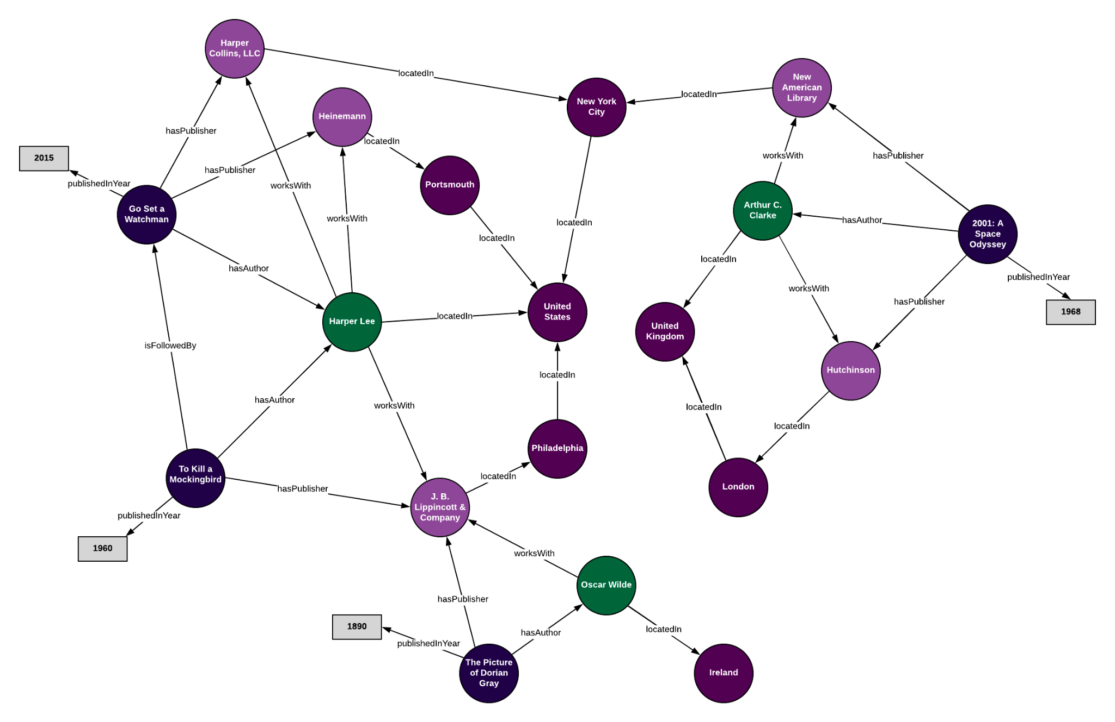
A Knowledge-base of Books

Slide 25
Graph Databases for storing and querying Knowledge Bases

Slide 26
What are graph databases
A graph database stores nodes and relationships instead of tables, or documents
Data is stored without restricting it to a pre-defined model - allowing flexibility
Nodes are the entities in the graph.
Nodes can be tagged with labels, representing their different roles in your domain. (For example, Person).
Nodes can hold any number of key-value pairs, or properties. (For example, name)
Node labels may also attach metadata (such as index or constraint information) to certain nodes
Relationships provide directed, named, connections between two node entities
Relationships always have a direction, a type, a start node, and an end node, and they can have properties, just like nodes.
Nodes can have any number or type of relationships without sacrificing performance.
Although relationships are always directed, they can be navigated efficiently in any direction.

Slide 27
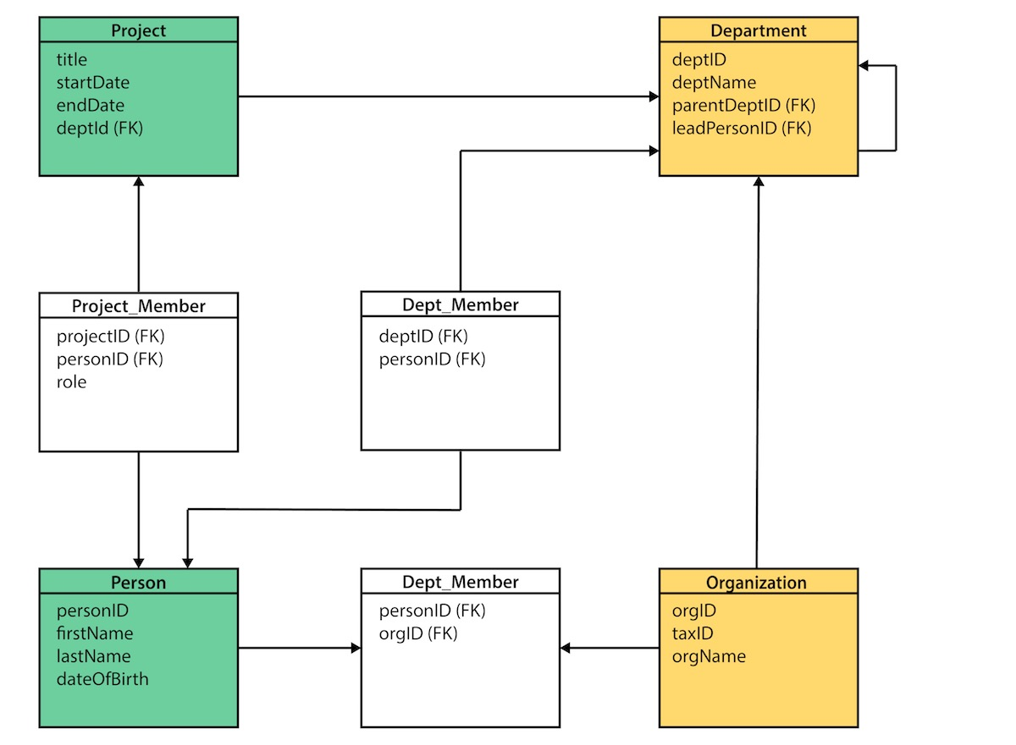
From Relational data to Knowledge Bases

Slide 28
Data Model transformation tips
Table to Node Label - each entity table in the relational model becomes a label on nodes in the graph model
Row to Node - each row in a relational entity table becomes a node in the graph.
Column to Node Property - columns (fields) on the relational tables become node properties in the graph
Add Constraints/Indexes - add unique constraints for business primary keys, add indexes for frequent lookup attributes.
Join tables to Relationships - join tables are transformed into relationships, columns on those tables become relationship properties

Slide 29
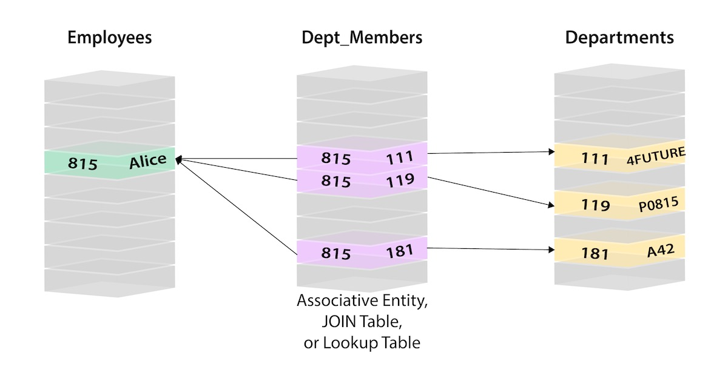
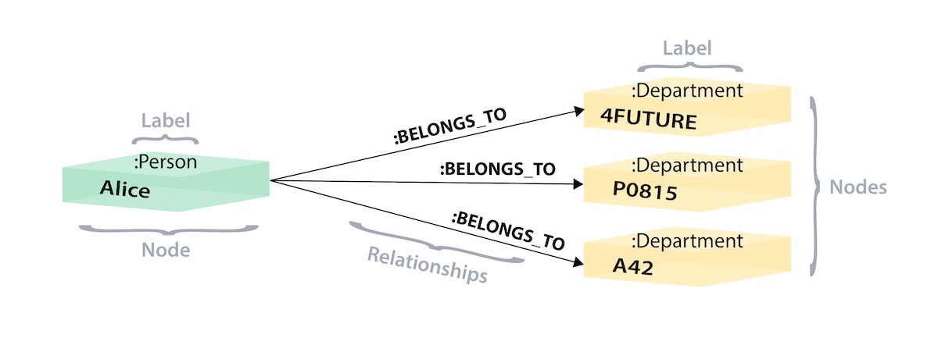
Table Entries become Nodes and Relations

Slide 30
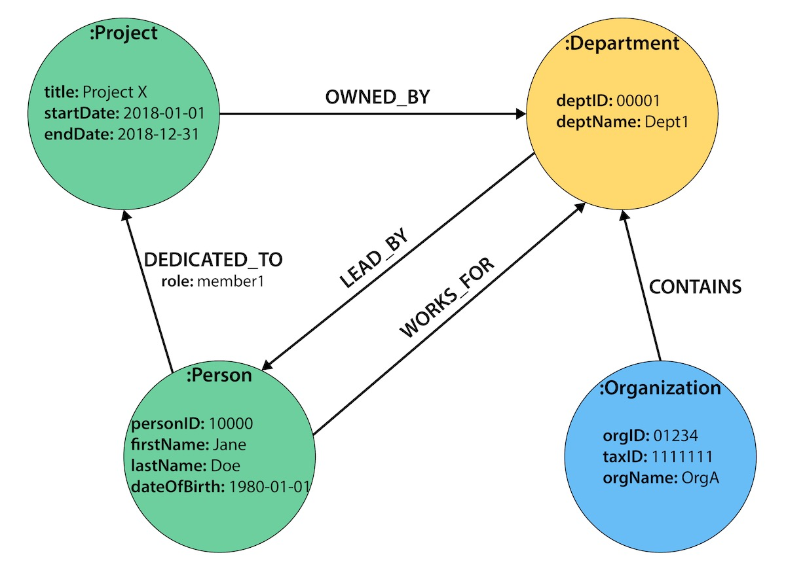
Table Data becomes a large graph

Slide 31
One query will do it
LOAD CSV WITH HEADERS FROM "FILENAME" AS row
MERGE (origin:Airport {code: row.Origin})
MERGE (destination:Airport {code: row.Dest})
MERGE (origin)-[connection:CONNECTED_TO {
airline: row.UniqueCarrier,
flightNumber: row.FlightNum,
date: date({year: toInteger(row.Year), month: toInteger(row.Month), day: toInteger(row.DayofMonth)}),
cancelled: row.Cancelled,
diverted: row.Diverted}]->(destination)
ON CREATE SET connection.departure = localtime(apoc.text.lpad(row.CRSDepTime, 4, "0")),
connection.arrival = localtime(apoc.text.lpad(row.CRSArrTime, 4, "0"))
Alternately - Create Labels, Add nodes, Add properties, Create relations

Slide 32
Sample Knowledge graph
Inputs
Patient Admission Data from Faith Hospital Database
Generic Drug Adverse Effect knowledge extracted from Medline abstracts and other Drug descriptions
Hospital Name | Patiend ID | Patient Name | Date | Disease | Medicine Prescribed
ABC | P1 | Anna | 05/12/2015 | Gastroenteritis | Macrogol 3 mg
Medicine | Drug
Macrogol 3 mg | Macrogol

Slide 33
Relation Extraction and Classification from Medical Literature
id | document | drug | disease | BERT Predicted Relation
442 | Diarrhea - associated over - anticoagulation in a patient taking warfarin : therapeutic role of cholestyramine . [SEP] warfarin [SEP] Diarrhea | warfarin | Diarrhea | ADE
443 | We present a case of significant over - anticoagulation temporally associated with a bout of protracted diarrhea in a patient on warfarin therapy . [SEP] warfarin [SEP] Diarrhea | warfarin | Diarrhea | ADE
1583 | CASE REPORT : A woman of 80 years , on long - term warfarin therapy presented with an acute dissecting thoracic aortic aneurysm ; on investigation the only precipitating factor found was an international normalised ratio of 4.8 . [SEP] acute dissecting thoracic aortic aneurysm [SEP] warfarin | warfarin | acute dissecting thoracic aortic aneurysm | ADE
6 | Oral macrogol is generally well tolerated. Possible side effects include headache, bloating, nausea, allergies, and electrolyte imbalance, mainly hypokalaemia (low blood potassium levels) and hyperkalaemia (high blood potassium levels). | Oral macrogol | hypokalaemia | ADE

Slide 34
Alternately - add nodes and relations
CREATE (Hospital:Pharmaceutical {title:'Pharmaceutical', released:2022, tagline:'Welcome to KG'})
CREATE (D:Concept {name:'Drug'})
CREATE (H:Concept {name:'Hospital'})
CREATE (S:Concept {name:'SideEffect'})
CREATE (T:Concept {name:'Person'})
CREATE(M:Concept {name:'Medicine'})
CREATE (MG:Drug {name:'Macrogol'})
CREATE (W:Drug {name:'Warfarin'})
CREATE (W1:Medicine {name:'Warfarin 1',dose:'1 mg'})
CREATE (W2:Medicine {name:'Warfarin RD',dose:'3 mg'})
CREATE (M1:Medicine {name:'Macrogol 1mg',dose:'Paediatric'})
CREATE (M2:Medicine {name:'Macrogol 3mg',dose:'Adult'})
CREATE (T1:Person{name:'Raya'})
CREATE (T2:Person{name:'Ava'})
CREATE (H1:Hospital{name:'Faith Nursing Home'})
CREATE (drh:SideEffect {name:'Diarrhoea'})
CREATE(hmc:SideEffect{name:'hematochezia'})
CREATE(bcpl:SideEffect{name:'bleeding_complication'})
CREATE(hmrg:SideEffect{name:'haemorrhage'})
CREATE(anysm:SideEffect{name:'acute_dissecting_thoracic_aortic_aneurysm'})
CREATE(cltng:SideEffect{name:'clotting'})
CREATE(bldng:SideEffect{name:'bleeding'})
CREATE(hdch:SideEffect{name:'headache'})
CREATE(bltng:SideEffect{name:'bloating'})
CREATE(nausea:SideEffect{name:'nausea'})
CREATE(allergy:SideEffect{name:'allergy'})
CREATE(elimblnc:SideEffect{name:'electronic_imbalance'})
CREATE(hypklm:SideEffect{name:'hypokalaemia'})

Slide 35
CREATE
(W1)-[:IS_A]->(W),
(W2)-[:IS_A]->(W),
(M1)-[:IS_A]->(MG),
(M2)-[:IS_A]->(MG),
(T1)-[:Admitted_to]->(H1),
(T2)-[:Admitted_to]->(H1),
(T1)-[:Prescribed]->(W1),
(T2)-[:Prescribed]->(M2),
(MG)-[:has_sideEffect]->(hdch),
(MG)-[:has_sideEffect]->(bltng),
(MG)-[:has_sideEffect]->(nausea),
(MG)-[:has_sideEffect]->(allergy),
(MG)-[:has_sideEffect]->(elimblnc),
(MG)-[:has_sideEffect]->(hypklm),
(W)-[:has_sideEffect]->(drh),
(W)-[:has_sideEffect]->(anysm),
(W)-[:has_sideEffect]->(cltng),
(W)-[:has_sideEffect]->(bldng)

Slide 36
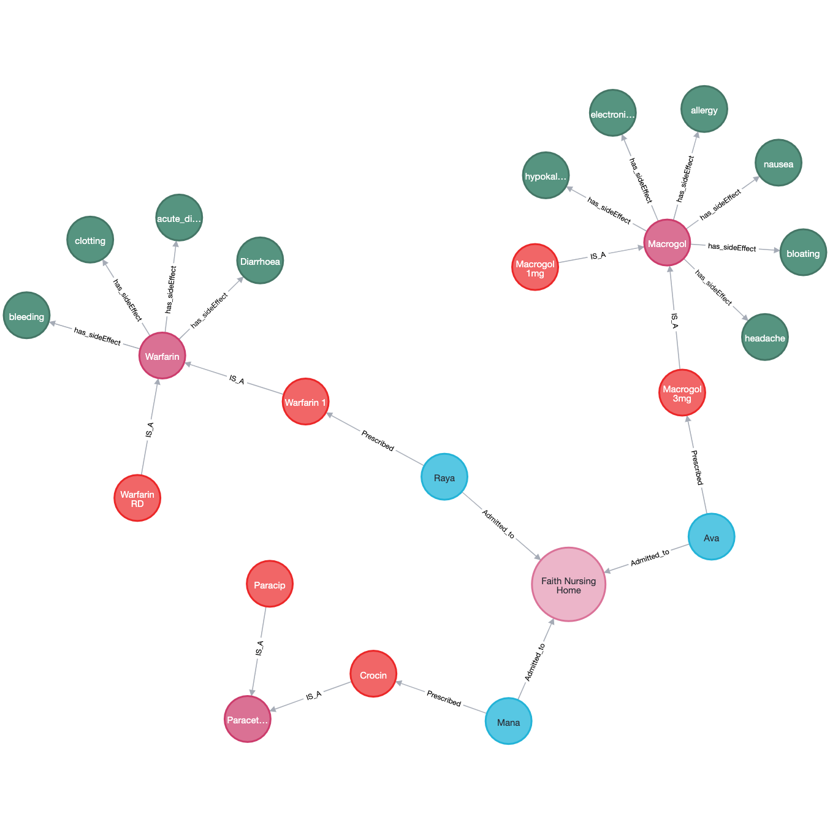

Slide 37
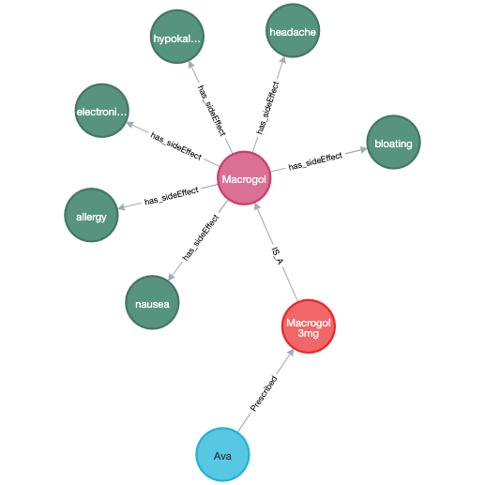
Querying Graph Databases
Cypher is graph Query Language for Developers and Users
Basic notion - allows you to ask the database to find data that matches a specific pattern
- “find things like this”
Do the medicines prescribed to Ava have any side effects?
MATCH (a:Person {name:'Ava'})-[:Prescribed]->(b:Medicine)-[:IS_A]->(c),
(c)-[:has_sideEffect]->(d)
RETURN a,b, c, d

Slide 38
WHERE
Provides criteria for filtering pattern matching results.
CREATE and CREATE UNIQUE
Create nodes and relationships.
MERGE
Ensures that the supplied pattern exists in the graph, either by reusing existing nodes and relationships that match the supplied predicates, or by creating new nodes and relationships.
DELETE/REMOVE
Removes nodes, relationships and properties.
SET
Sets property values and labels.
ORDER BY
Sorts results as part of a RETURN.
SKIP LIMIT
Skip results at the top and limit the number of results FOREACH
Performs an updating action for each element in a list.
UNION
Merges results from two or more queries.
WITH
Chains subsequent query parts and forwards results from one to the next. Similar to piping commands in Unix.

Slide 39
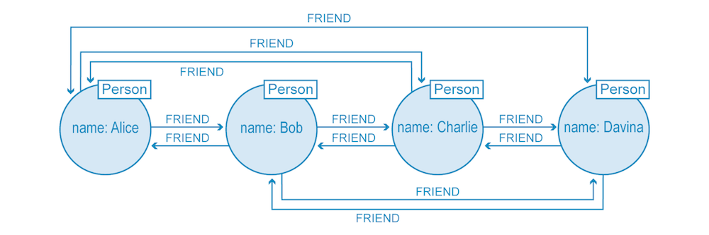
Efficiency of Graph Databases
Graph databases store relationship data as first-class entities
Relationships traversal in any direction is easier and faster with native graph processing
Predominantly index-free storage
Who are Alice’s friends?
Who are common friends of Bob and Charlie

Slide 40
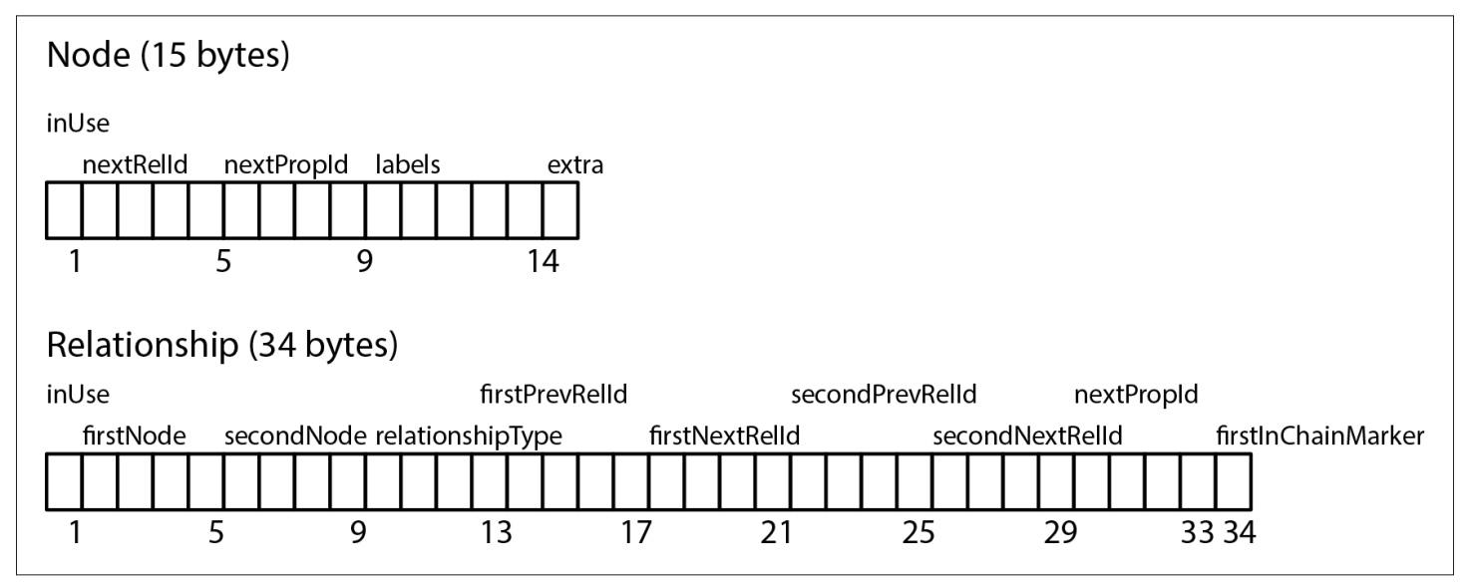
Neo4j stores graph data in a number of different store files
Each store file contains the data for a specific part of the graph - there are separate stores for nodes, relationships, labels, and properties
Every node created in the user-level graph ends up in the node store
Fixed-size records enable fast lookups for nodes in the store file
Fixed-size record store

Slide 41
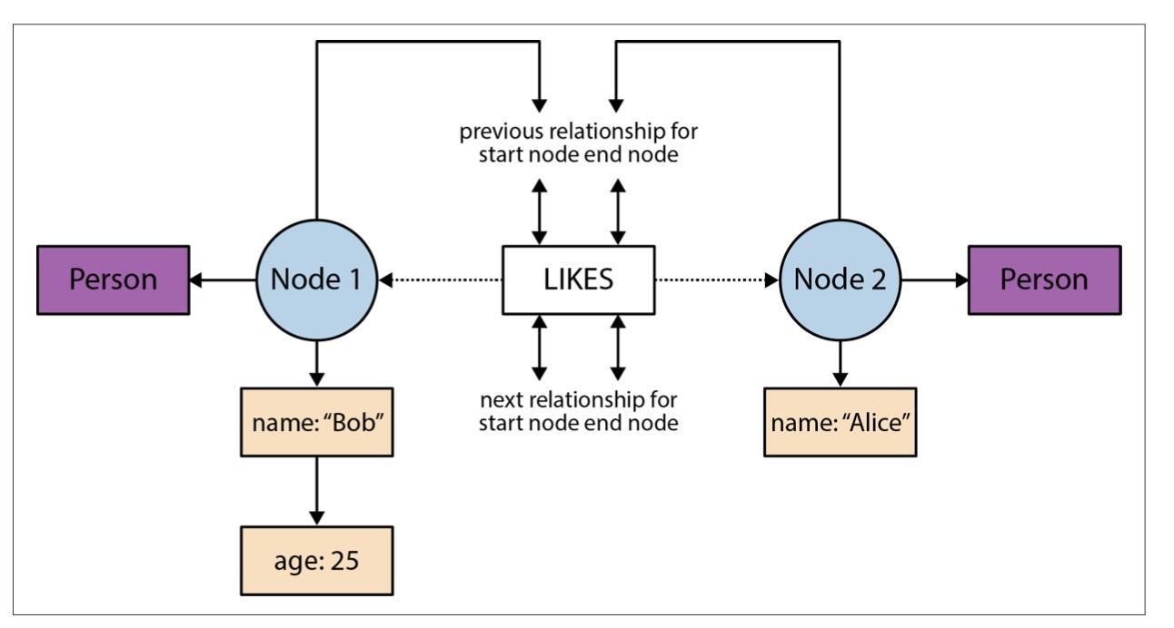
Relations as doubly-linked lists

Slide 42
Traversal
With fixed-sized records and pointer-like record IDs - traversals are implemented by chasing pointers around a data structure
From a given node record, locate the first record in the relationship chain by computing its offset into the relationship store—that is, by multiplying its ID by the fixed relationship record size. This gets us directly to the right record in the relationship store.
From the relationship record, look in the second node field to find the ID of the second node. Multiply that ID by the node record size to locate the correct node record in the store

Slide 43
Graph Algorithms
Graph Databases like Neo4J contains implementations for graph algorithms:
Path Finding - these algorithms help find the shortest path or evaluate the availability and quality of routes
Centrality - these algorithms determine the importance of distinct nodes in a network
Community Detection - these algorithms evaluate how a group is clustered or partitioned, as well as its tendency to strengthen or break apart
Similarity - these algorithms help calculate the similarity of nodes
Topological link prediction - these algorithms determine the closeness of pairs of nodes
Node Embeddings - these algorithms compute vector representations of nodes in a graph.
Node Classification - this algorithm uses machine learning to predict the classification of nodes.
Link prediction - these algorithms use machine learning to predict new links between pairs of nodes

Slide 44
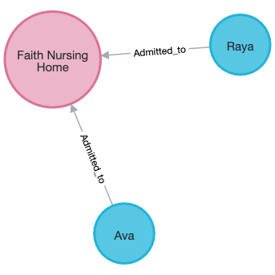
Graph Algorithms
What connects Ava and Raya?
MATCH (p1:Person { name: 'Ava' }),(p2:Person { name: 'Raya' }),
path = shortestPath((p1)-[*..15]-(p2))
RETURN path

Slide 45
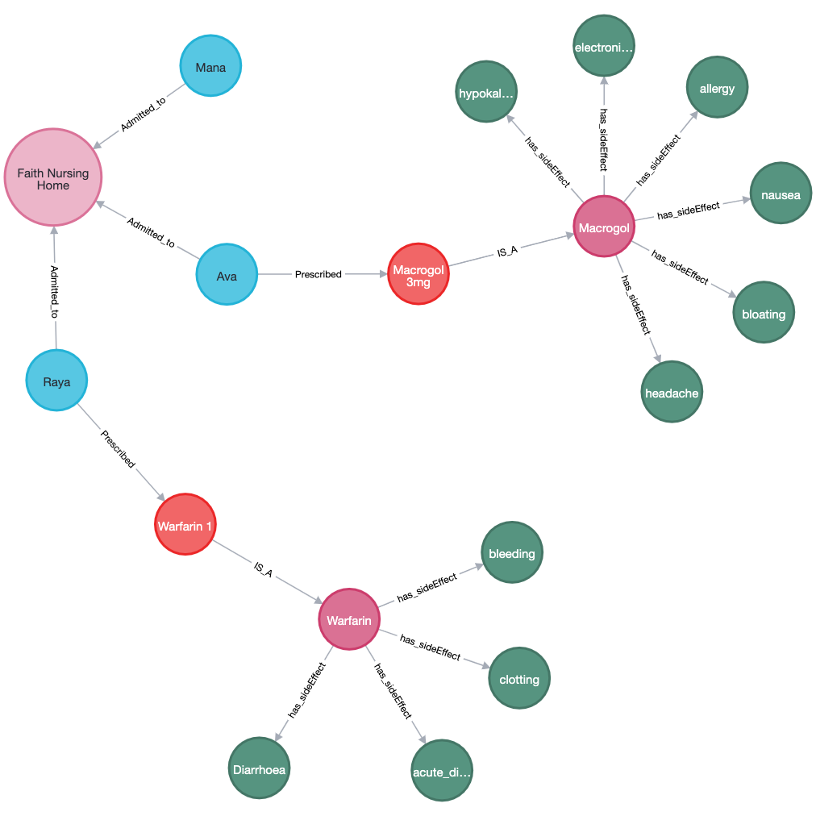
Caution - Danger of framing queries incorrectly
Do Mana’s medicines have a fear of causing adverse effects?
MATCH (p1:Person { name: 'Mana' }),(s:SideEffect),
path = shortestPath((p1)-[*..15]-(s))
RETURN path
No Semantic interpretation of edge names

Slide 46
Knowledge of graph structure should be used
Knowing the logic that
Person Prescribed Medicne ISA Drug Has_SideEffect Adverse_Event_name
MATCH (p1:Person { name: 'Mana' }),(s:SideEffect),
path = shortestPath((p1)-[*..3]-(s))
RETURN path

Slide 47
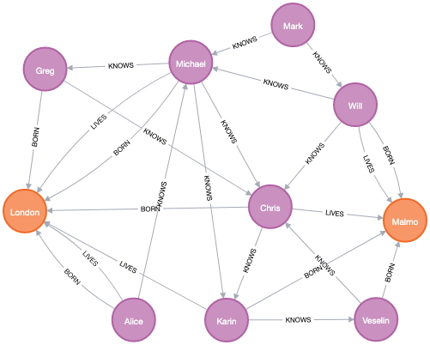
Link Prediction
Will Alice and Greg “know” each other soon?
Train the link prediction algorithm with source_nrode and target_node properties
Feature vector for the source node -
s=<p1, p2, …,pn>
is combined with the one for the target node -
t=<p1’, p2’, …,pm’>
into a single feature vector f

Slide 48
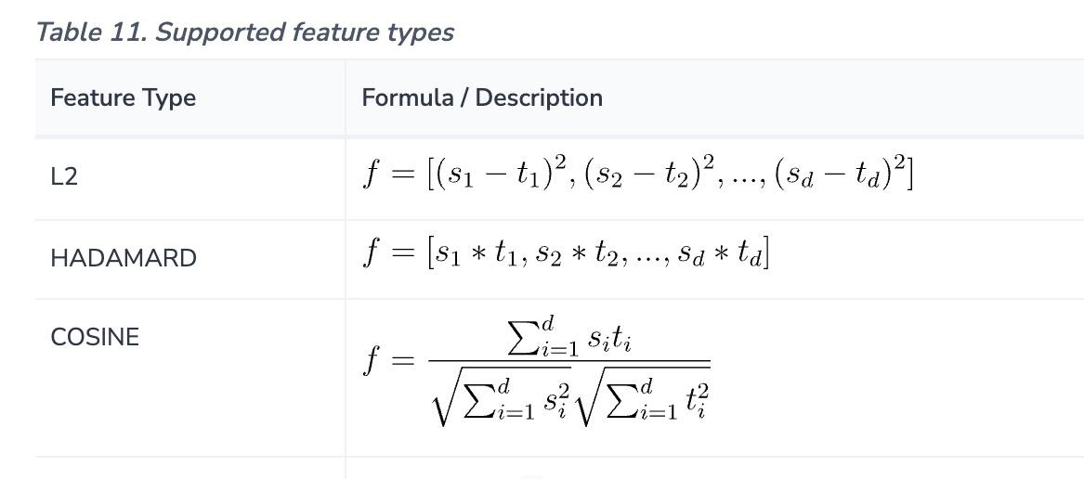
Supported Features for learning

Slide 49
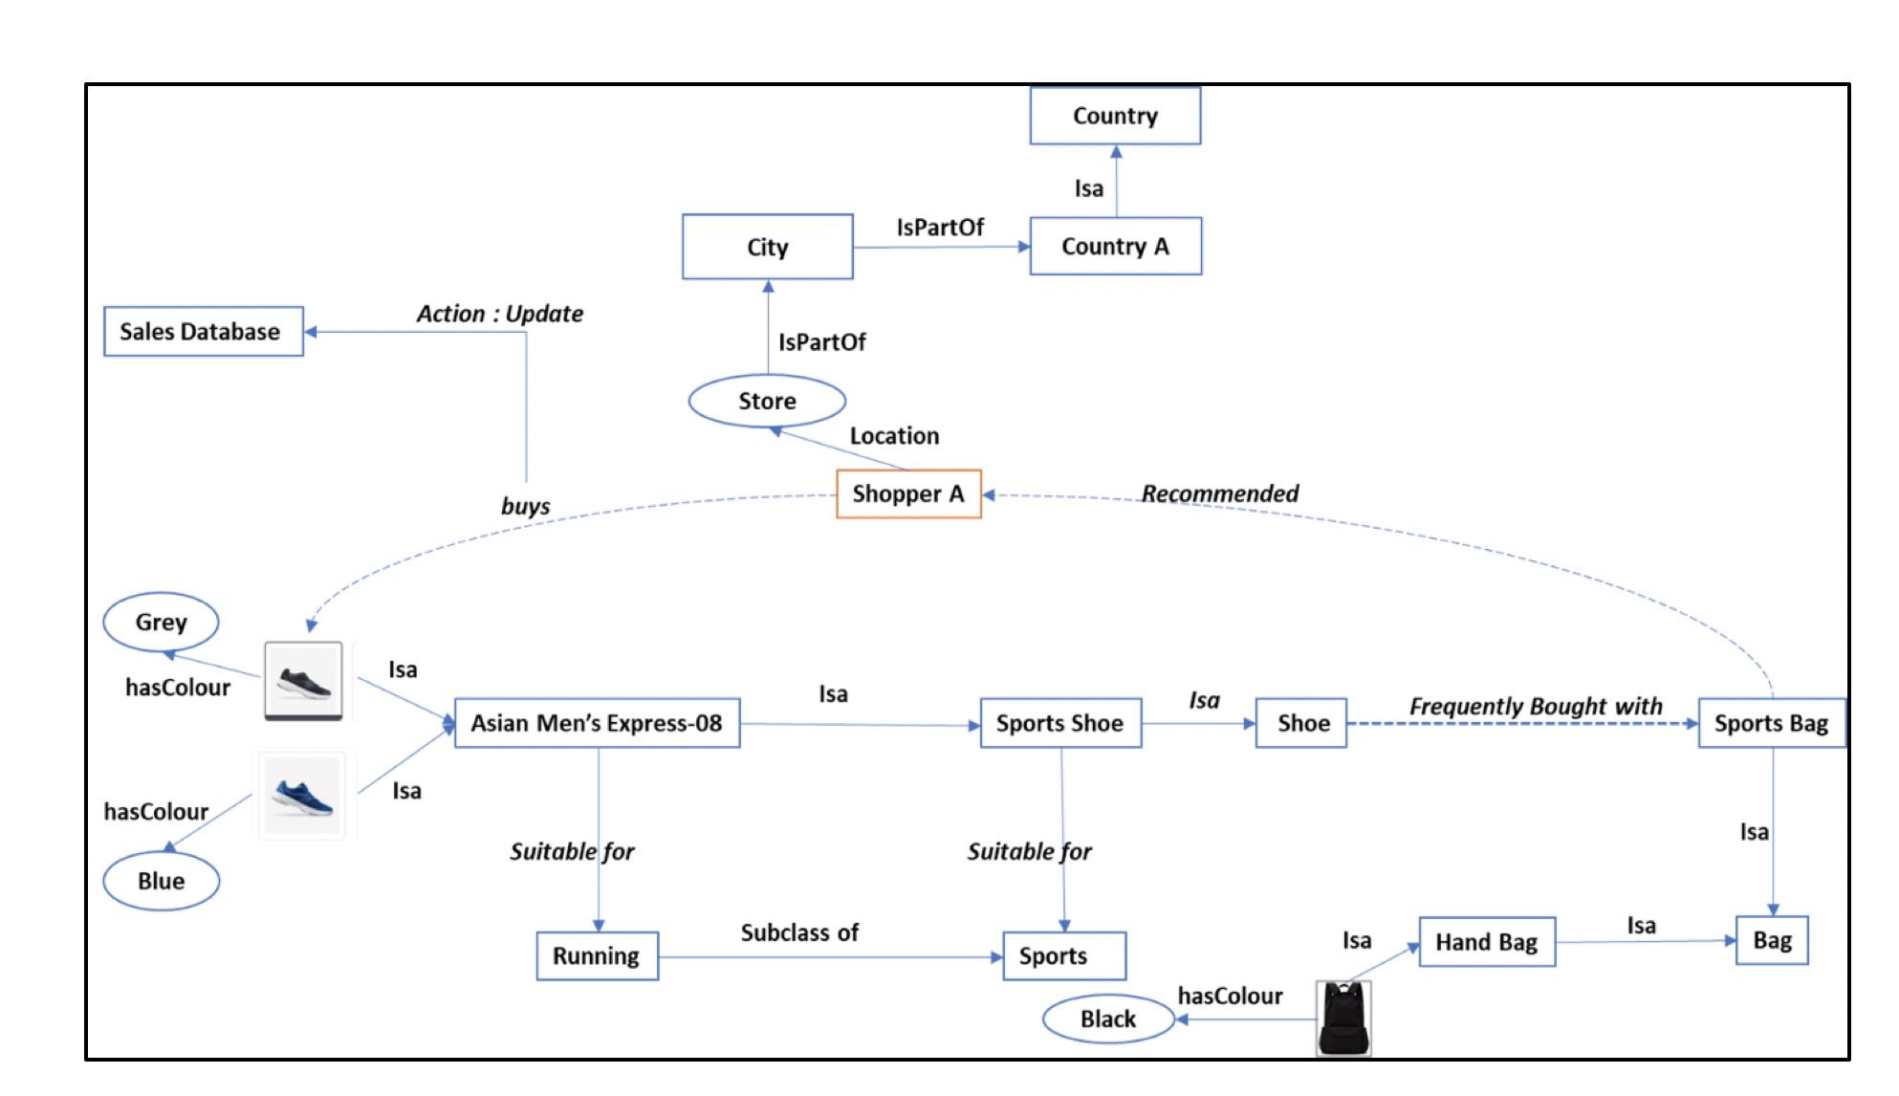
What are the possible items that a particular customer is likely to buy in near future?

Slide 50
Natural Language Question Answering over Knowledge Graphs
Knowledge - Graph Question Answering - KGQA
Business Analysts cannot be expected to write CYPHER or SPARQL queries for every input they need
Knowledge graphs store properties of nodes and their relations → can the semantics be exploited for Question Answering?

Slide 51
History
Natural Language Question Answering from Databases
From NLQ to SQl or Sparql
Question Answering from Web Documents
Open Domain Question Answering
Natural Language Query Answering using Knowledge Graphs
Knowledge Graphs contain consolidated knowledge stored as atomic facts, extracted from different sources, such as free text, tables in webpages or collaborative input
Machine Learning

Slide 52
The High-level Idea
Existing approaches
Transform the question to a structured KB query
Learn embeddings of questions and facts from Knowledge Graph in low dimensional vector space and retrieve the answer by computing similarities in this embedding space
Designing systems with higher reasoning capabilities, that could jointly retrieve and use multiple facts to answer
Most of the research is done for Freebase and Dbpedia data
Entities and relations are typed - and the lexicon for types and relationships is closed
Freebase data is collaboratively collected and curated, to ensure a high reliability of the facts
FB2M and FB5M are available for research

Slide 53
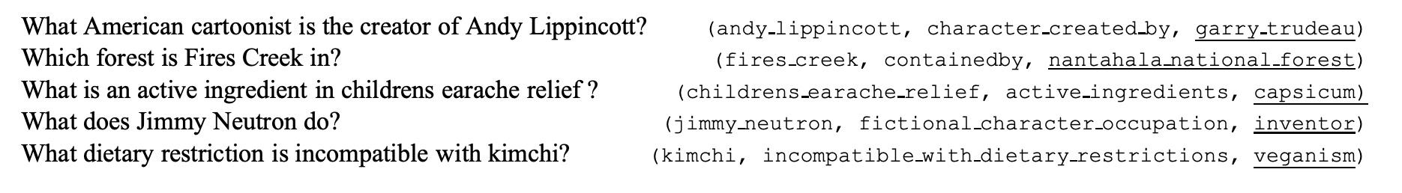
KGQA - a simple approach
Can the question be transformed to a structured query
(subject, relationship, ?)
What do Jamaican people speak? → (jamaica, language spoken, ?) for Freebase

Slide 54
KGQA - Bordes et al. 2015
Step 1 - for each subject s - for each relation r - merge all objects into a list
<s, r, o={o1, o2, …, on}>
Step 2: Additional relations are used from REVERB - to fine-tune the system
<s, rb, o> - where rb represents the relation as a bag of words
Step 3: Create embeddings for questions and answer triplets
Step 4: Training
Sim(Q,A) = argmax(Cosine similarity (Q, f’))

Slide 55
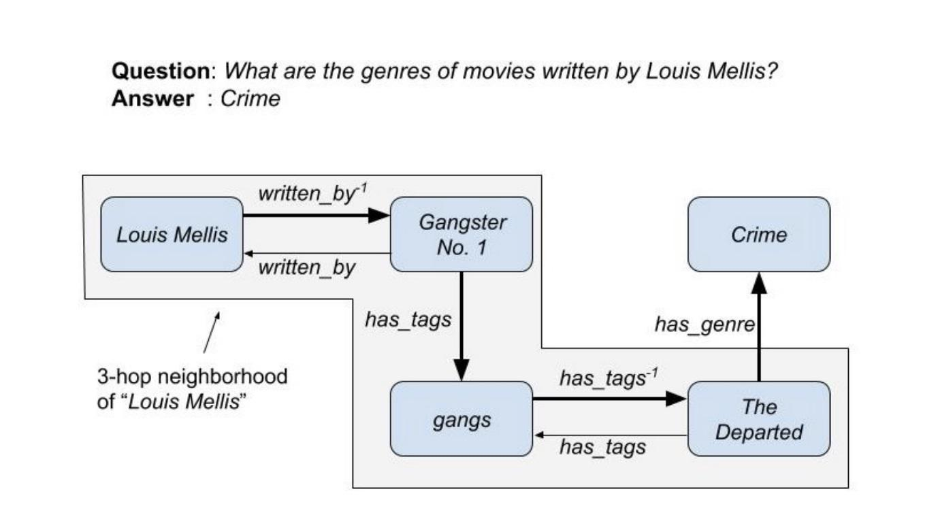
Multi-hop Question Answering

Slide 56
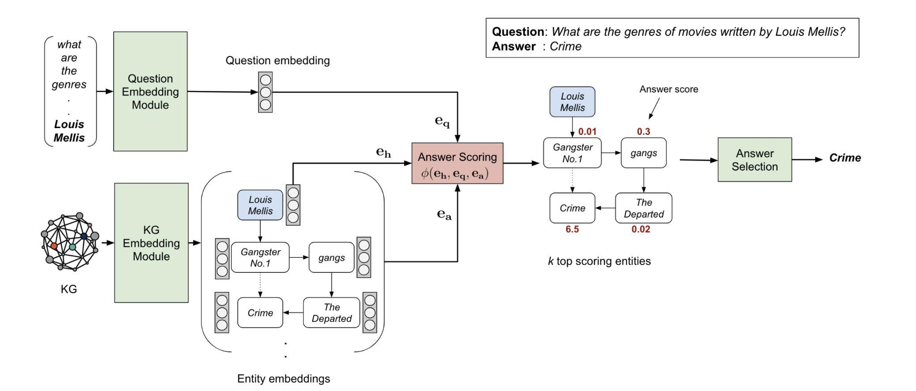

Slide 57
The Architecture
(1) Knowledge Graph (KG) Embedding Module learns embeddings for all entities in the input KG
Uses tensor factorization approach - ComplEx to learn KG embeddings for all triples
(2) Question Embedding Module learns an embedding for the question
Uses RoBERTa to learn the question in such a way such that its similarity to the ComplEx embeddings for the right entities is maximum
(3) Answer Selection Module selects the final answer by incorporating the question and relation similarity scores

Slide 58
And the research in ON!

Slide 59
Winding up!
Knowledge graphs hold the promise to improve content processing tasks especially in the context of a domain
Well-understood technology for knowledge representation and reasoning
Current implementations provide capability to work with a wide variety of data at scale and at speed
Semantic and Logical reasoning capabilities have to improve
- Learning semantic and practical constraints over data
- Temporal reasoning
-Mathematical reasoning

Slide 60
References
Graph Databases - O’Reily
Diefenbach, D., Lopez, V., Singh, K., & Maret, P. (2018). Core techniques of question answering systems over knowledge bases: a survey. Knowledge and Information systems, 55(3), 529-569.
Ji, S., Pan, S., Cambria, E., Marttinen, P., & Philip, S. Y. (2021). A survey on knowledge graphs: Representation, acquisition, and applications. IEEE Transactions on Neural Networks and Learning Systems, 33(2), 494-514.
Bordes, A., Usunier, N., Chopra, S., & Weston, J. (2015). Large-scale simple question answering with memory networks. arXiv preprint arXiv:1506.02075.
Saxena, A., Tripathi, A., & Talukdar, P. (2020, July). Improving multi-hop question answering over knowledge graphs using knowledge base embeddings. In Proceedings of the 58th annual meeting of the association for computational linguistics (pp. 4498-4507).
Livio Baldini Soares, Nicholas FitzGerald, Jeffrey Ling, Tom Kwiatkowski Matching the Blanks: Distributional Similarity for Relation Learning
Syed, M.H.; Chung, S.-T.: MenuNER: Domain-Adapted BERT Based NER Approach for a Domain with Limited Dataset and Its Application to Food Menu Domain. Appl. Sci. 2021, 11, 6007. https:// doi.org/10.3390/app11136007
Clark K., Manning C., Deep Reinforcement Learning for Mention-Ranking Coreference Models, EMNLP, 2016
Vashishth, S., Joshi, R, Prayaga, Sai S., Bhattacharyya, C, and Talukdar, P. Reside: Improving distantly-supervised neural relation extraction using side information

Slide 61
Resources
SemEVAL-2010 Task-8: https://semeval2.fbk.eu/semeval2.php?location=tasks&area=Semantic%20relations
KBP37: https://github.com/davidsbatista/Annotated-Semantic-Relationships-Datasets
The TAC Relation Extraction Dataset: https://nlp.stanford.edu/projects/tacred/
Riedel: https://github.com/davidsbatista/Annotated-Semantic-Relationships-Datasets/blob/master/README.md
GIDS: https://research.googleblog.com/2013/04/50000- lessons-on-how-to-read-relation.html

